Slide 1
Financial Independence: Knowing when you can “retire”
Major jason “lytic” gargan

Slide 2
So What? (& Disclaimer)
Personal finance is personal… but a lot of people do not understand how to get ahead
Military service offers amazing financial benefits
What do you value in life?
Disclaimer: I am not a trained financial professional. I am not a personal finance expert. I am a nerd who takes interest in personal finance and enjoys bringing value in people’s lives. Any action or decision you make as a result of this is your responsibility.

Slide 3
Overview
What/Why/How FI?
Deployment Challenge

Slide 4
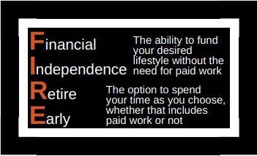
What is FI?
FI or Financial Independence is the moment your investments start paying more than your expenses
FI is essentially a math equation
FI is also mentality of working (or not!) because you want to and not for the paycheck
FIRE (RE = Retire Early) is a community of people looking to optimize FI in the quickest manner to “retire”
Why do I keep putting quotes around “retire?”
Military service is one of the most optimized way to be FI

Slide 5
The Why of FI
Military Dollar Podcast
(Many personal pictures removed)

Slide 6
How do you know when you are FI?
4% Rule of Thumb
Withdraw 4% of your investment portfolio first year of “retirement”
Adjust for inflation every year after that
Based off research: 1994 William Bengen,1998 Trinity Study, multiple others
For this to work, you need 25x your annual expense
100% / 4% = 25 | Example: $60,000 annual expense, need $1.5m to be FI
Need to calculate budget from “retirement” mentality
Budgets may go down as kids leave, smaller house (or paid off), less daily commute
Other sources of income count! Reduces delta of annual expense & FI#
Pensions, Social Security, rental property income, side projects
Example above, O-5 @ 20 year = ~$50k | $60k - $50k = 10k * 25 = $250,000
FI#
Source: https://militarydollar.com/2017/11/11/introduction-4-rule/

Slide 7
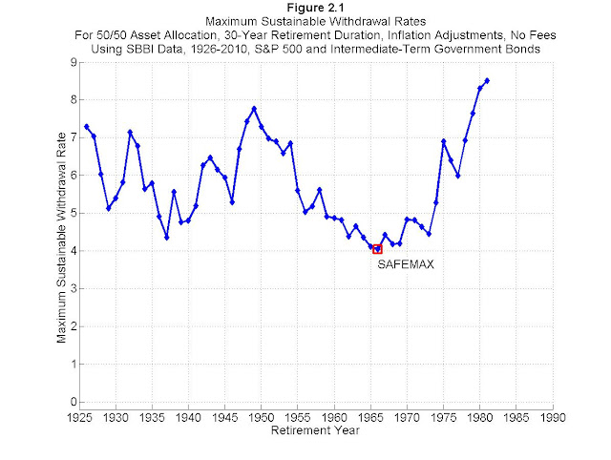
Why the 4% rule works
Historical data on stock/bond returns
Even in the worst market conditions/timing, 4% lasted at least 33 years
3.5% safe withdrawal rate works for all timing
Assumptions – Average real market return is 7%
Life expectancy
Inflation does not average more than 3% per year
Investment strategy (risk tolerance)
Research on your own: Rule 72(t), Drawdown Percentage, Possibility of Failure Rates, Dynamic Updating, Safe Withdrawal Rate
Source: https://www.madfientist.com/safe-withdrawal-rate/

Slide 8
How to achieve FI?
BE A VALUIST!
Reduce expenses:
Low cost housing
Buy used cars, use your car longer
Reduce grocery bill
Tax optimization
College hacking
Travel rewards
Cut the cord
Move to low-cost of living area
Increase Income:
Side Hustle
Teach online
AirBnB
Rental Properties
Get promoted
Increase savings:
Savings rate – TSP & IRA
Low cost index fund investing
Source: https://www.choosefi.com/10-pillars-of-fi/

Slide 9
Deployment Challenge
BE A VALUIST!
#1. Reduce expenses
Can you reduce expenses while you are deployed?
#2. Pay Debt
Interest is an unneeded annual expense
#3. Max Savings Deposit Program (SDP)
$10k → guaranteed 10% regardless of market
#4. Max Thrift Savings Plan (TSP) annual contribution
$19k (Roth?) in 2019
#5. Max Individual Retirement Account (IRA)
$6k in 2019
#6. Max TSP deployment increased limit or open taxable investment account
$56k total ($19k in Roth* with an additional $37k in Traditional)
Consider tax considerations for traditional TSP vs regular investment account
BE A SAVER!
* = cannot fill Roth $19k first

Slide 10
Conclusion
Military makes FI very possible
TSP is super low cost (0.04% expense ratio)
Tricare insurance for retirees
BRS (for those opted in) gives flexibility
Military pension not taxed in a lot of states
Significant tax savings while active (BAH, COLA, CZTE, etc)
Random military discounts & MLA (no annual fees on some credit cards)

Slide 11
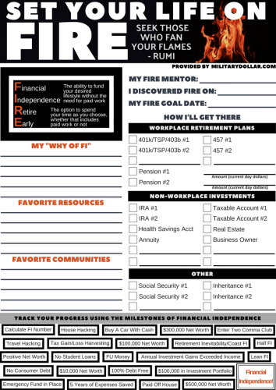
Helpful Sources Specific for Military
militarydollar.com
militaryguide.com
grumpusmaximus.com
katehorrell.com
themilitarywallet.com
militarylifeplanning.com
hermoneymoves.com
Questions?

